Slide 1




Machine Learning for Design and Discovery of New Energetic Molecules Daniel C. Elton, Ph.D. 6/4/18

Slide 2
Overview of our grant
Goal:
To accelerate the discovery of new energetic (explosive) molecules by using machine learning methods instead of traditional physics-based simulation for screening.
Thrust 1: Dataset construction
Build dataset on energetic molecules and properties (finished 8/17)
Identify design heuristics by searching literature and by interviewing subject matter experts
My focus
Thrust 2: Machine Learning
Machine learning for property prediction (finished 1/18)
Interpretation of machine learning models (finished 4/18)
(extra) Generative models
Perform quantum & thermochemical simulations to test newly generated molecules, use outputs from simulations as new training data.
Thrust 3: Natural Language Processing (“semantic discovery”)
Ingest pdfs and book scans to ASCII text, extract sentences
Identify chemical names (named entity recognition)
Test word embeddings (word2vec, GloVe, functional embedding)
Use word embeddings to associate chemicals with properties and functionalities. Build a “recommender system” for molecules.

Slide 3

UMD-ETC machine learning team
Prof. Peter W. Chung
Computational materials science, energetic materials
Prof. Mark D. Fuge
Machine learning
data-driven design
Dr. Ruth M. Doherty
Energetic materials
chemistry, formulations
Dr. Bill Wilson
Energetic materials
properties, effects
Dr. Daniel Elton (Ph.D., Physics, ’16)
Machine learning
regression, generative models
Dr. Zois Boukouvalas (Ph.D., Math, ‘17)
Machine learning
dimensionality reduction
Mark S. Butrico (MechEng BS, ‘19)
Classification (moving to ARL this summer)
Nischal Reddy (CS BS, ‘18)
NLP – word embeddings
Austin Kim (CS BS, ‘21)
Classification
Dhruv Takhia (Telecomm. MS, ‘19)
NLP – word embeddings
Minh Truong (CS BS, ‘19)
NLP – named entity recognition

Slide 4
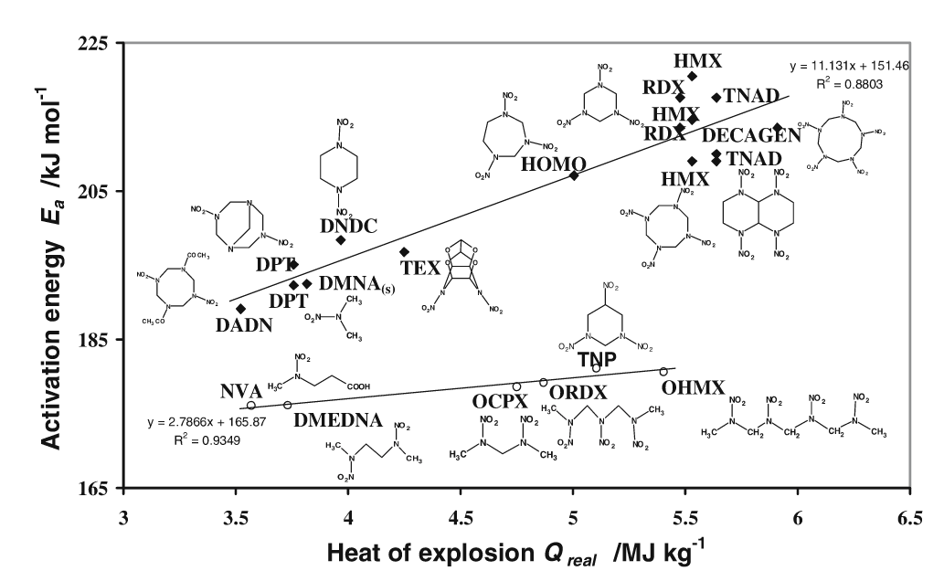
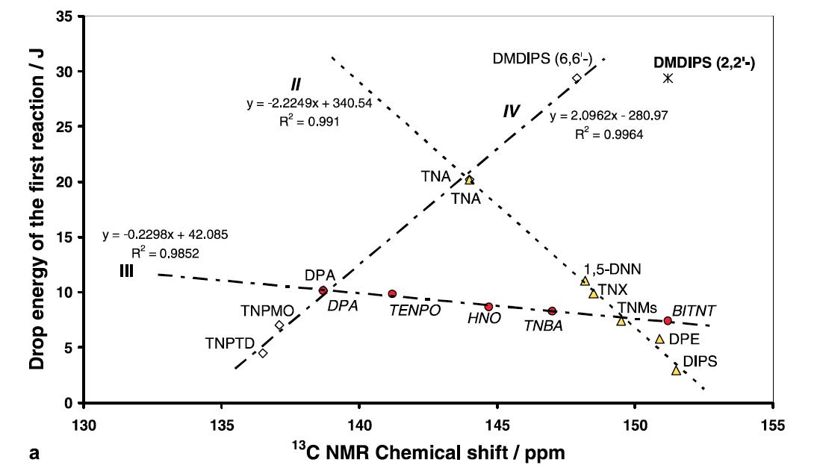
Previous modeling of energetic properties
Linear regression only
Single hand-picked feature used
Each linear model is restricted to a single compound class
Compound classes differ significantly in structure-property relations
Sensitivity measurement
S. Zeman, in High Energy Density Materials (Ed: T. M. Klapötke), Springer-Verlag, Berlin 2007.

Slide 5
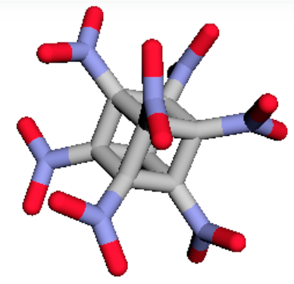
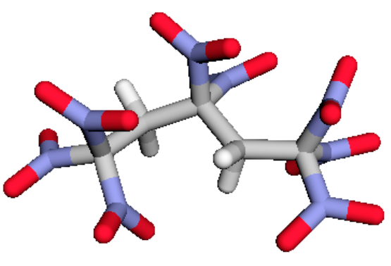
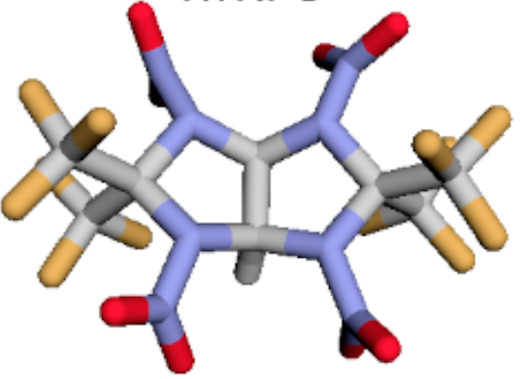
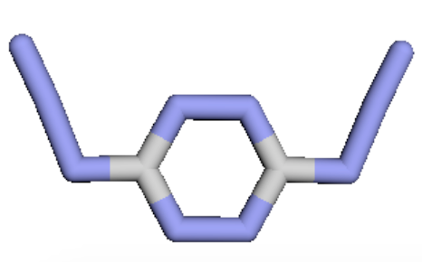
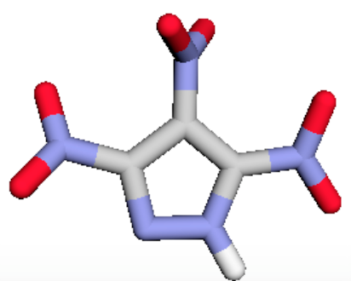
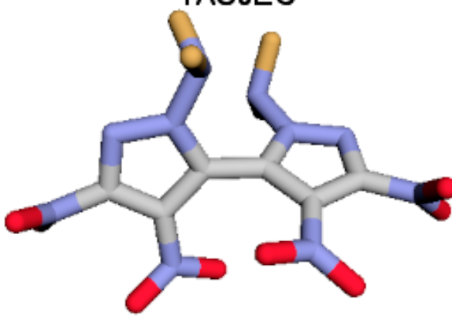
Our approach
Goal:
Predict properties over many compound classes with a single model
Test many model types & latest featurizations developed for molecules (last 5 years)
Property data of Huang & Massa¹
109 molecules, 10 compound classes
DFT & CHEETAH thermochemical code²
9 properties – density, heat of formation, explosive energy, shock velocity, particle velocity, sound velocity, detonation pressure, detonation temperature, and TNT equivalent per cc
1.) Huang, L. & Massa, L. Int. J. Ener. Mat. Chem. Prop. 12 , 197–262 (2013)
2.) Huang, L., Massa, L. & Karle, J. Int. J. Ener. Mat. Chem. Prop. 10 , 33–44 (2011)

Slide 6
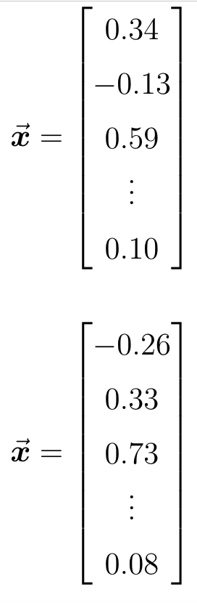
Featurization
Feature vector
2D Molecular graph
SMILES String
C1N(CN(CN1[N+](=O)[O-]
)[N+](=O)[O-])[N+](=O)[O-]
featurization method
3D Molecular structure
Feature vector
(x,y,z) coodinates
featurization method

Slide 7
Featurization methods tested
Oxygen balance
Custom descriptor set
Fingerprinting
Sum over bonds
Custom graph convolutional fingerprints
Coulomb matrices
Bag of bonds
Based on stoichiometry only
Based on 2D molecular graph
Based on 3D structure

Slide 8
Models explored
Linear regression
Ridge regression
LASSO regression
Bayesian ridge regression
Elastic net regression
Kernel ridge regression
Support vector regression
k nearest neighbors
Gaussian process regression
Random forests
Gradient boosted trees
Neural network
variants of linear regression
Decision tree based

Slide 9
Systematic comparison
TNT equiv.
Temperature
Heat of formation
Detonation pressure
Explosive energy
Sound velocity
Particle velocity
Featurizations
Shock velocity
Models
Density
…
…
…

Slide 10
Model accuracies
density
heat of formation
explosive energy
~4% error
~1-100% error
~12% error
detonation velocity
detonation pressure
speed of sound
~10% error
~5% error
~5% error

Slide 11
Data dependence
Detonation velocity
~ 10 % error
Cutting error in half requires increasing # of training molecules by 10 x
~ 6.5% error
Theoretical limit with our current best featurization & model
~ 5% error

Slide 12
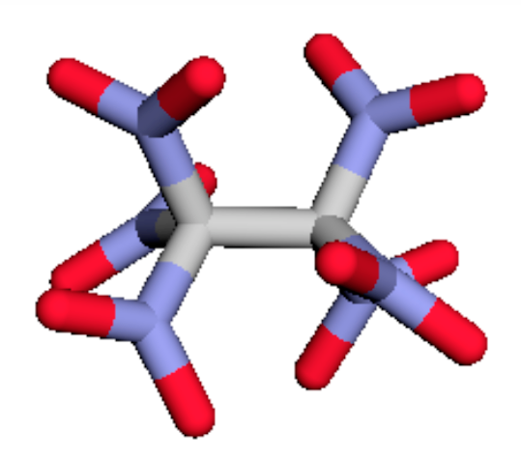
Model interpretation
Forward modeling
Molecular structure
Properties
model
Inverse modeling
Properties
Molecular structure
Interpretation of model
?
Reasons for interpretation:
To ensure the model is capturing known structure – property relationships
To discover new structure – property relationships
To discover latent features the model is using that may be useful for human designers

Slide 13
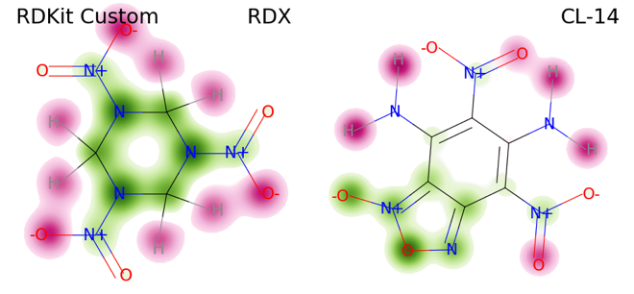
One interpretation method : sensitivity analysis
removal of a red atom causes the model to increase its predicted detonation velocity. therefore red atoms are associated with lower detonation velocity according to the model
Not all featurizations yield intuitive sensitivity analysis maps like this!!
See upcoming International Detonation Symposium paper for discussion & caveats

Slide 14
Feature ranking
Ranking of features associated with higher or lower detonation velocity
Results align with chemical intuition here.
See upcoming International Detonation Symposium proceedings paper for discussion & caveats

Slide 15
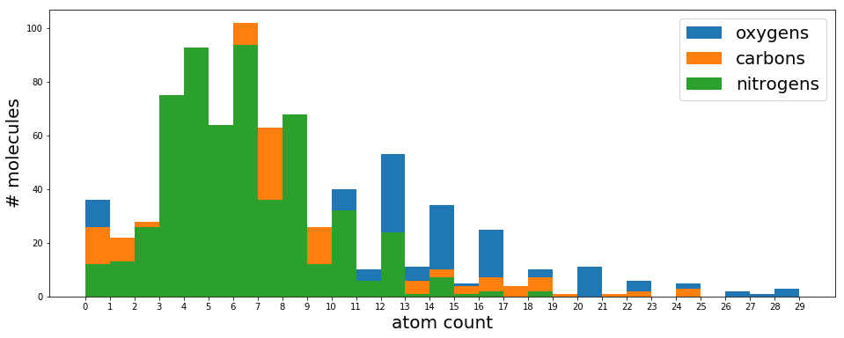
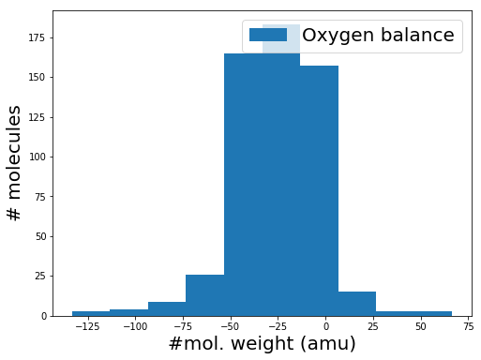
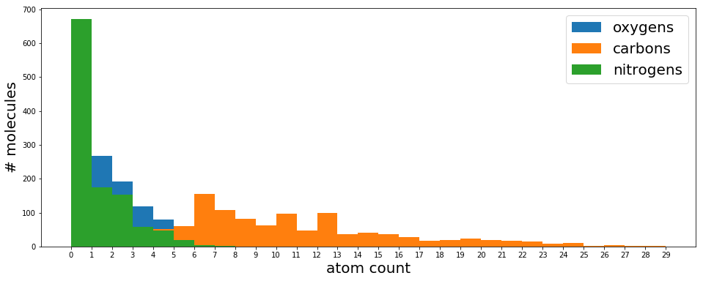
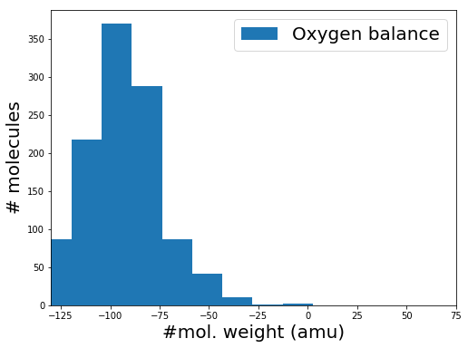
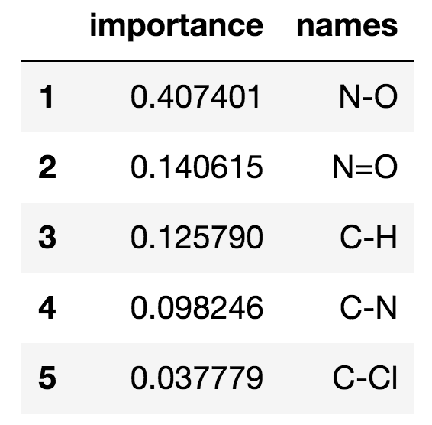
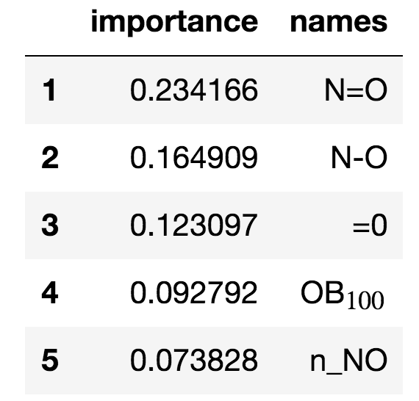
Classification
ROC curve
617 energetic molecules
~ 96 % accuracy
atom counts oxygen balance
1,128 non energetics - Delaney solubility dataset
mostly pesticides and agrochemicals
Random forest feature importances
atom counts oxygen balance

Slide 16
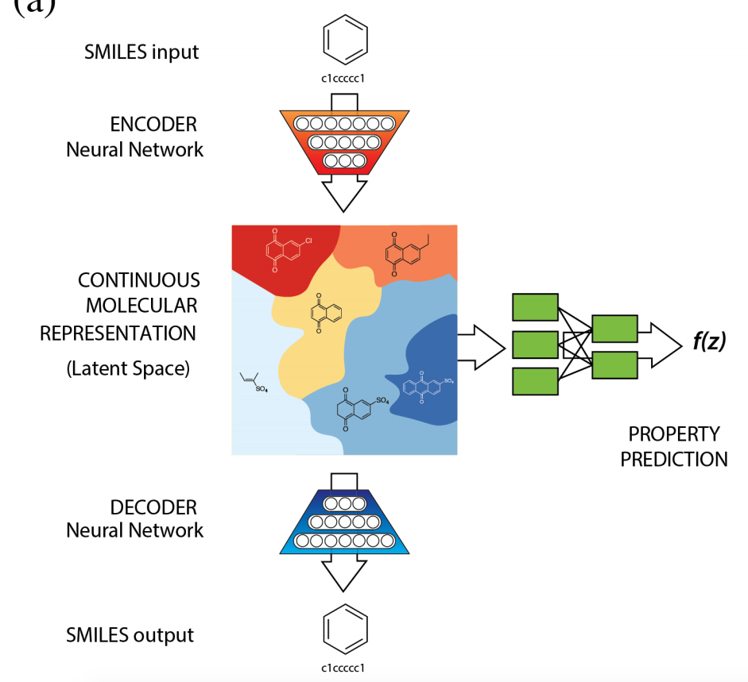
Generative method #1 Variational autoencoders
Stage 1: training autoencoder to learn low dimensional latent representation
attach property predicting model (or physics code)
New leads for further screening
Stage 2: optimization in latent space to find molecules which maximize target property
Figures from
Gómez-Bombarelli et al. ACS Cent. Sci., (2018) 10.1021/acscentsci.7b00572
Aspuru-Guzik group, Harvard.

Slide 17
Molecular Generation with Deep Learning Architectures
Very hot area - new papers coming out every month
Variational Autoencoders (VAEs)
Molecular autoencoder, Gomez-Bombarelli, Aspuru-Guzik, et al. ACS Central Science, 2018
Deep adversarial autoencoder, Kadurin, et al. Oncotarget, 8(7) p. 10883, (2017)
novel hybrid architecture – VAE but has GAN discriminator working on the latent space variables to enforce drug-likeness and drug binding properties
Generative Adverarial Networks (GANs)
ORGANIC Sanchez-Lengeling, Aspuru-Guzik, et al. 2018, chemrxiv:5309668
based on ORGAN, Guimaraes, Aspuru-Guzik, et al. 2017, arxiv:1705.10843v3
based on SeqGAN, Yu, et al. 2017, AAAI-17 proceedings
uses reinforcement learning with policy gradients (Sutton et al. 1999)
Reccurent Neural Networks (RNNs)
Olivecrona, et al. 2017 (Astrazenca)
Neil, Segler, et al. ICLR 2018 (BenevolantAI)
Bjerrum and Threlfall, arXiv:1705.04612 (Wildcard Pharmaceutical Consulting)

Slide 18
Generative method #2 Generative Adversarial Networks
Generator
network
Was D right?
x
Training SMILES
x
?
N(=O)[N+](=O)C
O=CN(N(=O)=O)N(=O)=O
O=NCC(N(=O)=O)N(=O)=O
C(N(=O)=O)(N(=O)=O)(N(=O)=O)N(=O)=O
ON(=O)=O
C(N(=O)=O)N(=O)=O
O(N(=O)=O)N(=O)=O
C(F)C(=O)N(=O)
C(N(=O)=O)CN(N(=O)=O)C
….
Discriminator
D(x)

Slide 19
ORGAN Objective Reinforced GAN
rewards for good properties
Objective property predicting module
Generator
Network
LSTM + RL
Was D right?
x
Training SMILES
x
?
N(=O)[N+](=O)C
O=CN(N(=O)=O)N(=O)=O
O=NCC(N(=O)=O)N(=O)=O
C(N(=O)=O)(N(=O)=O)(N(=O)=O)N(=O)=O
ON(=O)=O
C(N(=O)=O)N(=O)=O
O(N(=O)=O)N(=O)=O
C(F)C(=O)N(=O)
C(N(=O)=O)CN(N(=O)=O)C
….
Discriminator
D(x)
CNN
Sanchez-Lengeling, Aspuru-Guzik, et al. 2018, chemrxiv:5309668
Guimaraes, Aspuru-Guzik, et al. 2017, arxiv:1705.10843v3

Slide 20
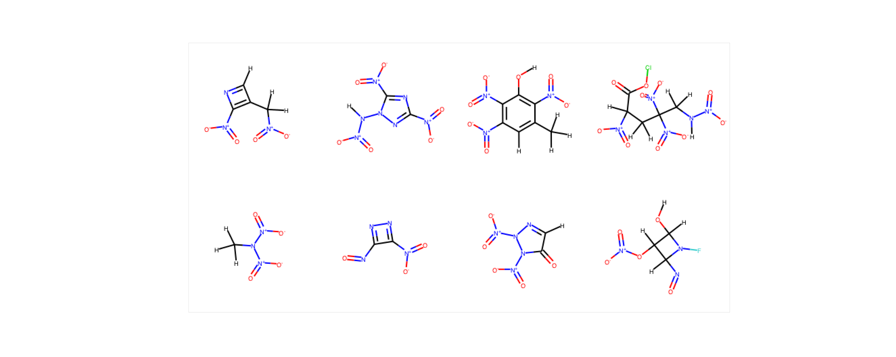
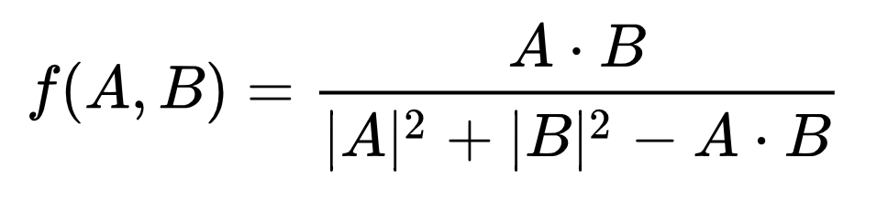
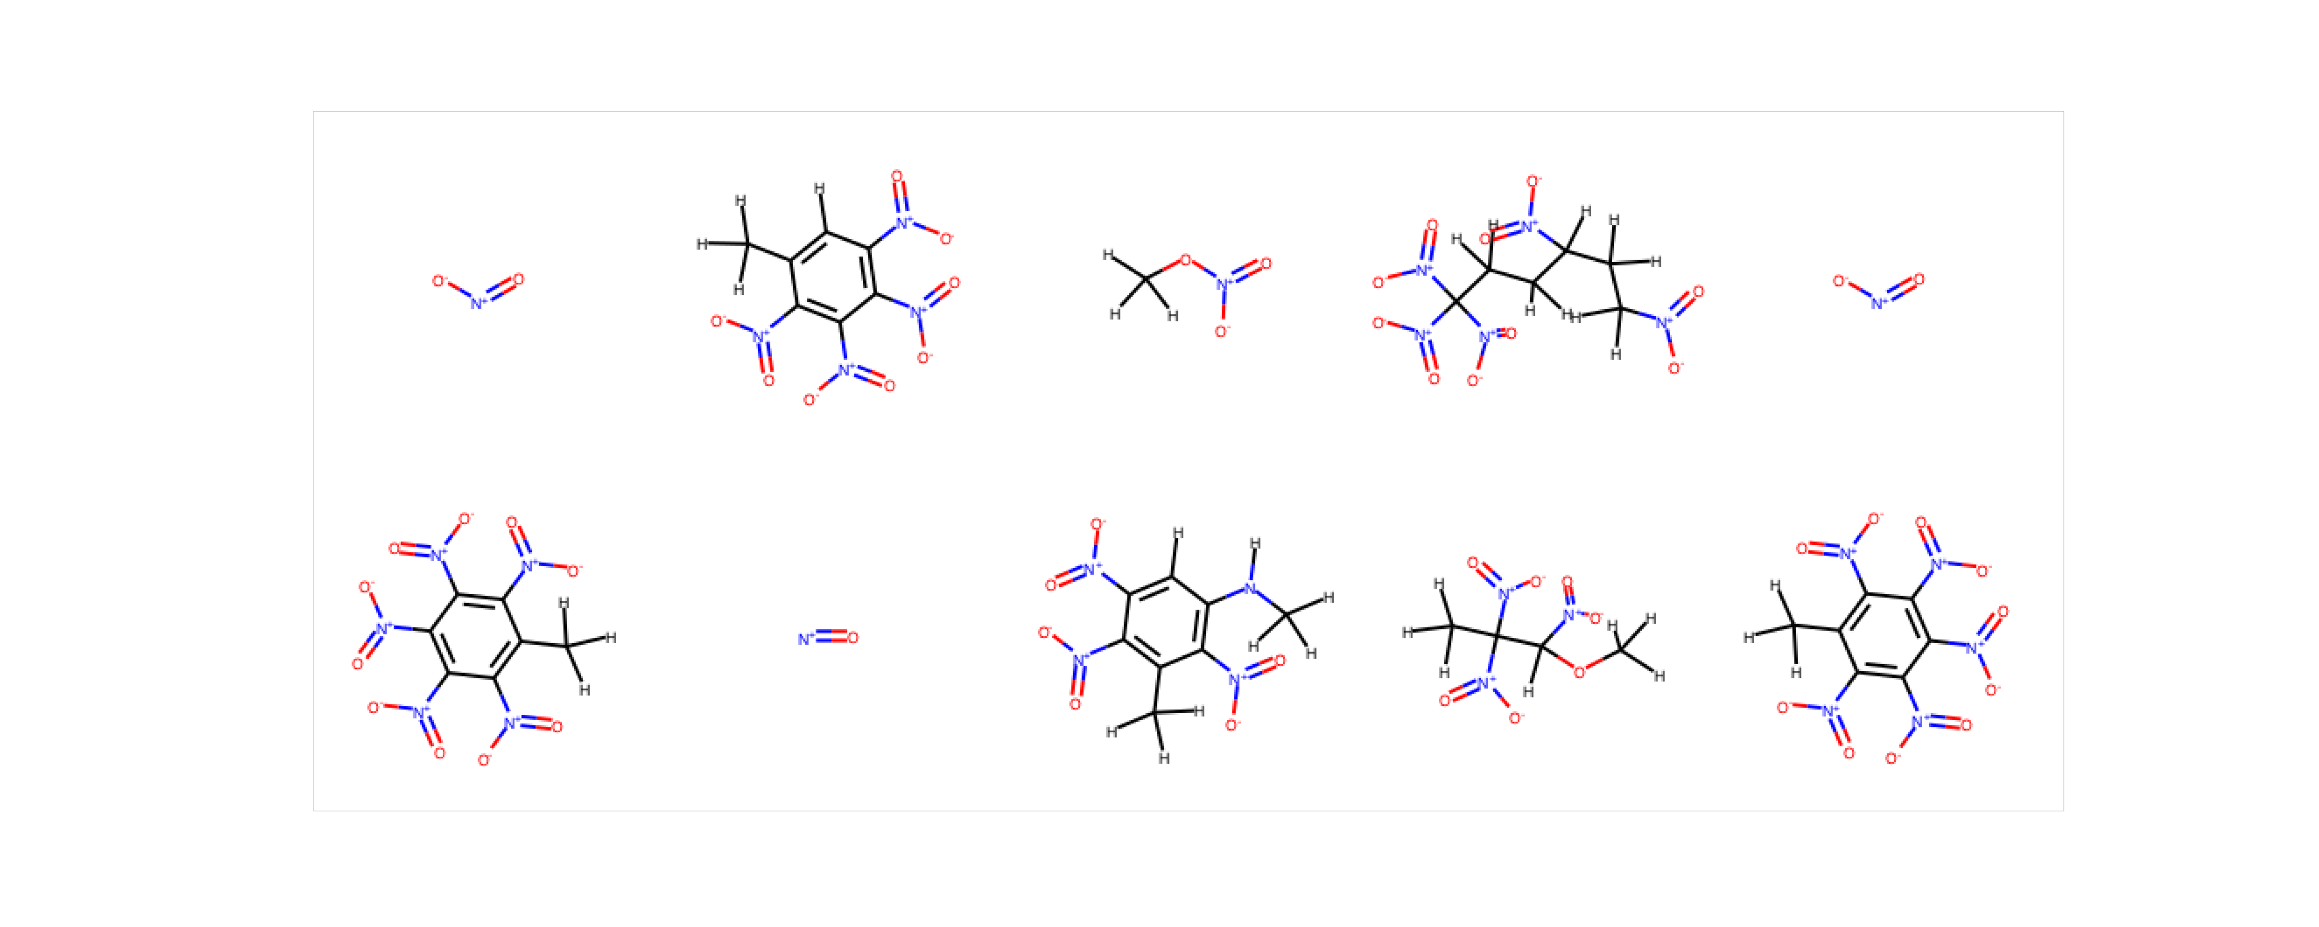
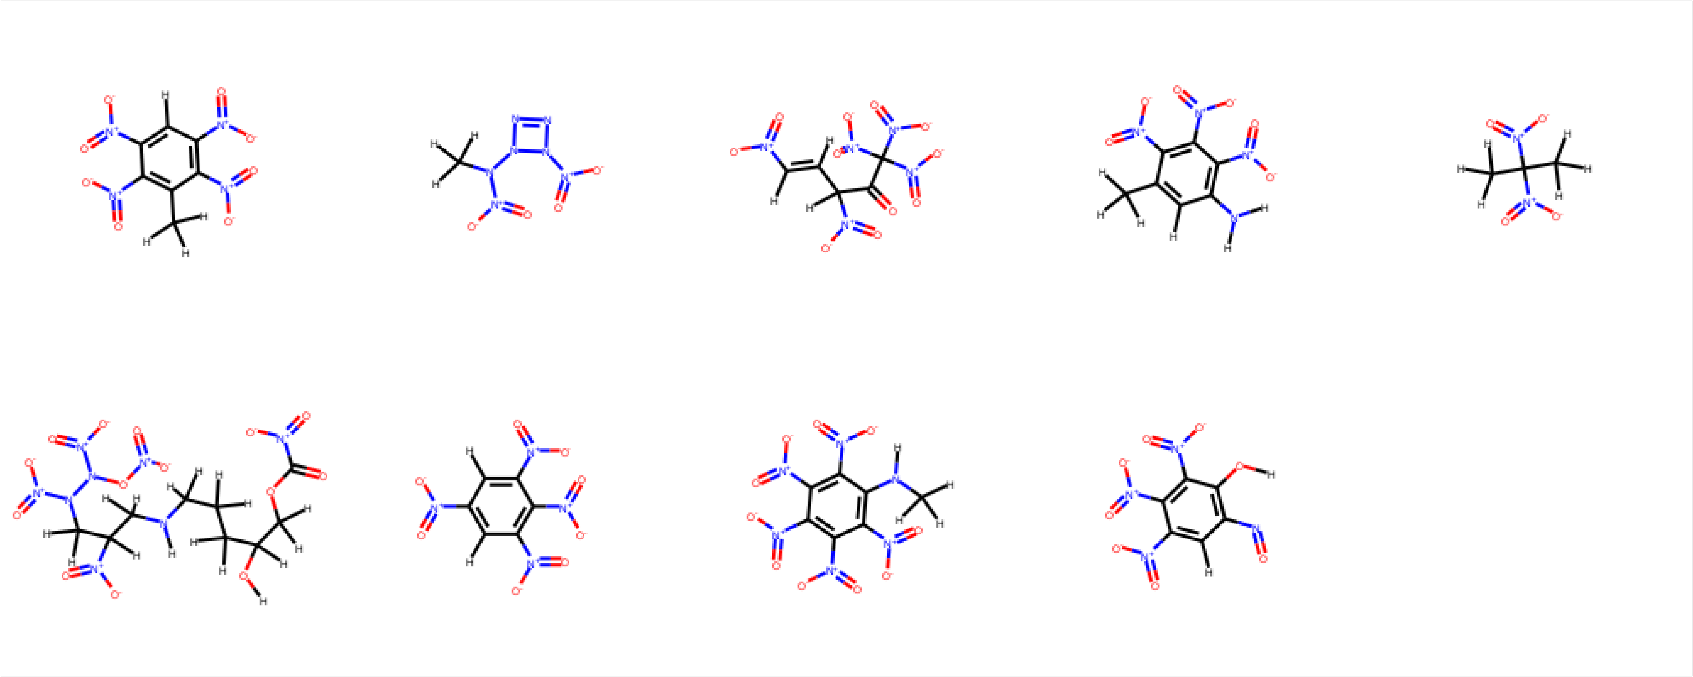
ORGANIC GAN Initial results
Trained on 580 organic (CNOHFCl) energetic molecules
Epoch 1
Batch rewards for variety (avg. in group distances)
and diversity (avg. distance to random sample of training data)
Jaccard / Tanimoto distance
Epoch 48
Not all of the ones generated
are synthesizable!

Slide 21
“Molecular Tinder”
Allows subject matter experts to be part of screening pipeline and train deep learning models
R. Gómez-Bombarelli et al., Design of efficient molecular organic light-emitting diodes by a high-throughput virtual screening and experimental approach, Nat. Mater. 15, p. 1120-1127, 2016.

Slide 22

Summary
We presented a proof of principle that machine learning for property prediction and classification is feasible starting with small dataset of energetic materials
We showed how how feature ranking can illuminate structure-property relations
We showed initial efforts towards molecular generation and how it might be incorporated into a screening pipeline
Acknowledgments
Office of Naval Research (N00014-17-1-2108)
Energetics Technology Center (2044-001)
Center for Engineering Concepts Development (CECD)
Our paper:
D. C. Elton, Z. Boukouvalas, M. S. Butrico, M. D. Fuge, and P. W. Chung, “Applying machine learning techniques to predict the properties of energetic materials” accepted in Scientific Reports, 2018 (arXiv:1801.04900)
Upcoming paper in the 2018 Detonation Symposium (collaboration with ARL)
B. C. Barnes, D. C. Elton, Z. Boukouvalas, D. E. Taylor, W. D. Mattson, M. D. Fuge, and P. W. Chung, “Machine Learning and Discovery for Energetic Materials”, in 16th International Detonation Symposium, Cambridge MD, USA, July 2018.
Open Source Python Molecular Machine Learning Toolkit
https://github.com/delton137/mmltoolkit

Slide 23
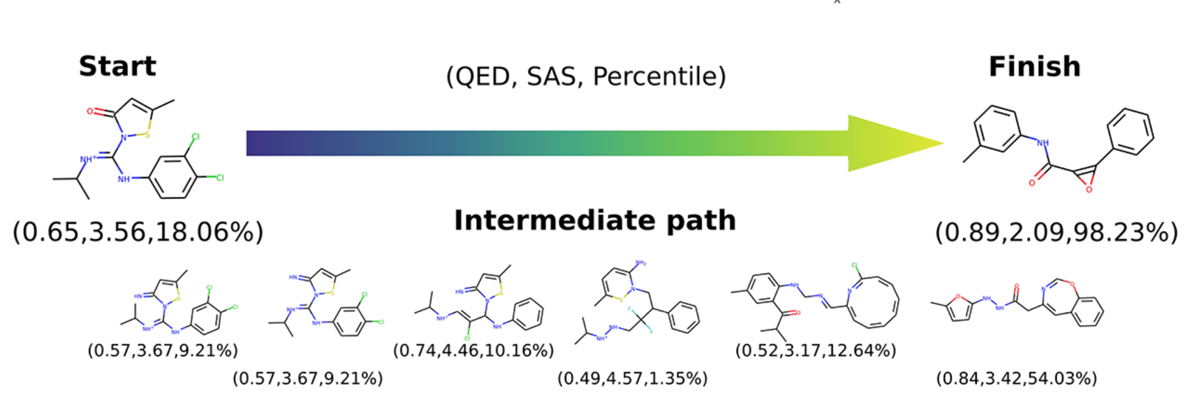
Molecular autoencoder Prior work at Harvard
Optimization of
Quantitative Estimation of Drug-likeness
Synthetic accessibility score
Results from Gómez-Bombarelli et al. ACS Cent. Sci., (2018) 10.1021/acscentsci.7b00572
Aspuru-Guzik group, Harvard.

Slide 24
My background
D. C. Elton, M. Fritz, and M.-V Fernández-Serra. “Using a monomer potential energy surface to perform approximate path integral molecular dynamics simulation of ab-initio water at near-zero added cost” (arXiv:1803.05740), 2018
D.C. Elton “The microscopic origin of the Debye relaxation in liquid water and fitting the high frequency excess response” Phys. Chem. Chem. Phys., 19, 18739 (2017)
D.C. Elton and M.-V Fernández-Serra. “The hydrogen bond network of water supports propagating optical phonon-like modes” Nat. Comm. 7, 10913 (2016)
D.C. Elton and M.-V Fernández-Serra. “Polar nanoregions in water – a study of the dielectric properties of TIP4P/2005,TIP4P/2005f and TTM3F” J. Chem. Phys., 140, 124504 (2014)

